Slide 1
Human Factors
Lecturer: Ngo Huy Bien
Software Engineering Department
Faculty of Information Technology
VNUHCM - University of Science
Ho Chi Minh City, Vietnam
nhbien@fit.hcmus.edu.vn

Slide 2
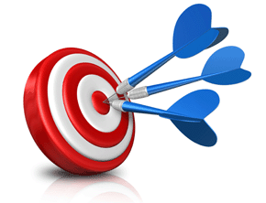
Objectives

Slide 3

Contents

Slide 4

References
Zachary Wong (2007). Human Factors in Project Management. Jossey-Bass.
Peter Scholtes (1988). The Team Handbook. Joiner Associates Inc.

Slide 5
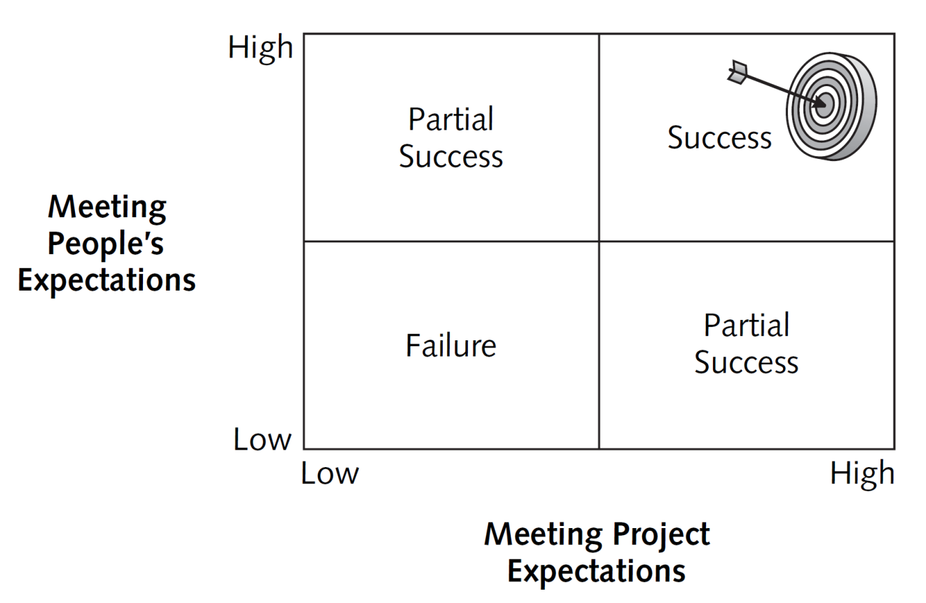
Project Success [1]

Slide 6
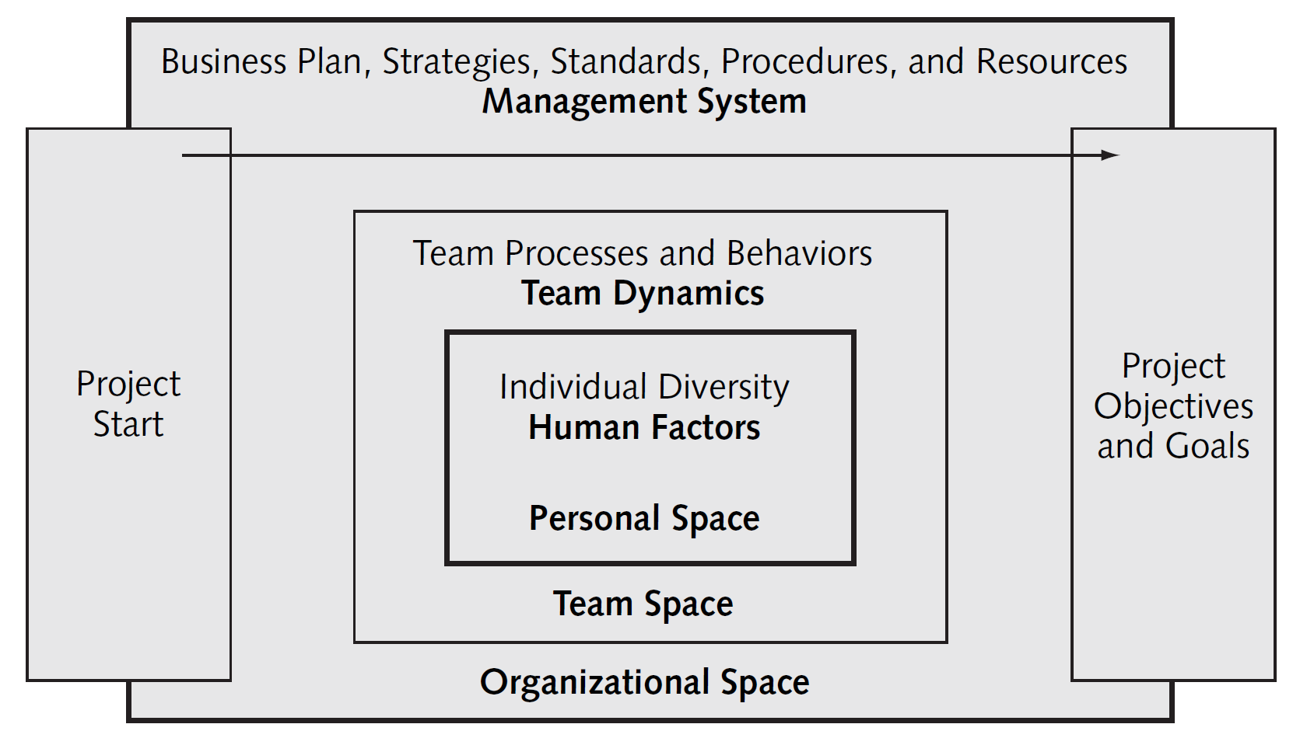
Three Spaces of Project Management
Project teams are influenced by three conceptual spaces: organizational, team, and personal.

Slide 7

Personal Values
Our values are rooted in our personal culture, experiences, and personality type.
From our values, we have personal expectations and desires.
We are inspired when we feel our desires are attainable and supported by organizational and team space.
For example, we may believe that hard work will lead to a promotion.
For us to feel motivated and inspired, that belief needs to be reinforced by organizational space.
Health
Wealth
Security
Justice
Learning
Freedom

Slide 8

Organizational Values
Company values are rooted in its history and institutional memory.
There are three ways to identify your company's values:
The company's vision, mission, objectives, and value statements
The company's policies and key decisions
The behaviors of managers and peers
Having stated values alone does not create a values-based organization.
These values must be demonstrated in actions; otherwise, they are just words on a page.
Innovation
Salaries
Teamwork
Trust
Respect

Slide 9

Personal vs. Organizational Values
If a person's values are not in strong alignment with those of the company, then conflicts will occur.
When company values do not match your values, you may be forced to change your behaviors.
Some people can readily adopt new behaviors.
However, when behavioral modifications are made at the expense of your core values, those you believe in deeply, you will likely pay an emotional price.
You may feel stressed at work, anger easily at work and at home, or work less diligently.

Slide 10
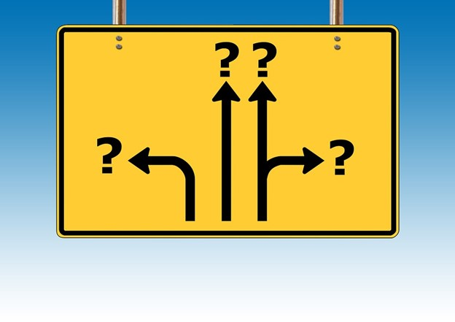
Test the Disparity
Do you find yourself talking about the company's values to your spouse, family, and friends?
Do you speak up in support of your company's values at work?

Slide 11


Slide 12
Individual Diversity
First, we need to recognize that people come from different cultures in life, and each of those cultures has a unique language, customs, beliefs, foods, music, and other sociological factors.
Second, people of specific generations demonstrate similar behaviors and beliefs that are derived from their shared life experiences.
Third, research has demonstrated that people are born with similar preferences or psychological typing.

Slide 13
David Keirsey's Temperament Types
Rationals provide competitive drive, logic, analytical skills, critical thinking, innovation, and initiative. They connect ideas, thoughts, and facts to form a strategic view and actions for a team.
Idealists contribute patience, collaboration, thoughtfulness, sensitivity to people, intuition, and teamwork. They connect people and feelings to issues.
Artisans generate energy, emotions, speed, actions, creativity, and fun. They help a team embrace change, see opportunities, take risks, and break paradigms.
Guardians bring organization, processes, production, discipline, accuracy, and stability. They are able to successfully execute work plans and processes to meet team objectives.

Slide 14
Build a Team
Each type shows a different behavioral pattern for learning, processing information, communicating, and interacting with their environment.
No single type is better or worse for project management.
Each type has special strengths and weaknesses.
When these types are blended together on a team, the diversity of personalities generates greater creativity and higher-quality work than any one type can accomplish alone.

Slide 16
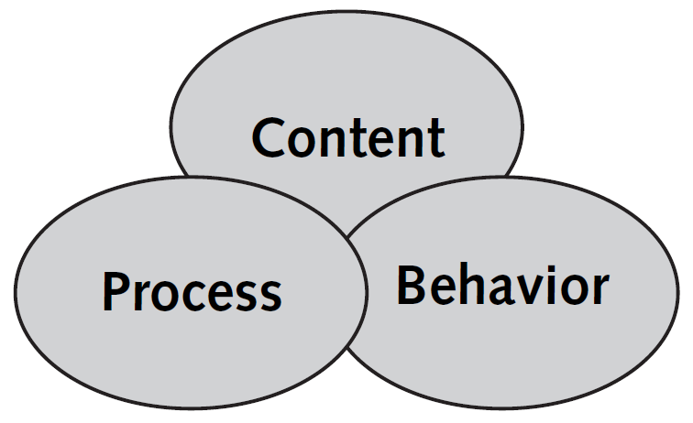
Key Elements of Team Performance
Content is the “what” or intent of the team—the vision, objectives, direction, opportunities, strategies, and assumptions.
Process is the “how”—the tools and procedures that help a team reach its objectives.
Behavior is the collective human interactions of the team, the observable human actions and team dynamics.
These three factors are interdependent variables and must be in place and working in synergy for a project team to be successful.

Slide 17

Interdependent Variables
The key to any high-performing team is the team's ability to
develop and agree on the key purpose, goals, and plans of the project (content);
use the right tools, techniques, and procedures to implement the team's work plan (process); and
communicate, collaborate, and work in synergy (behavior).
These three factors are interdependent variables and must be in place and working in synergy for a project team to be successful.

Slide 18
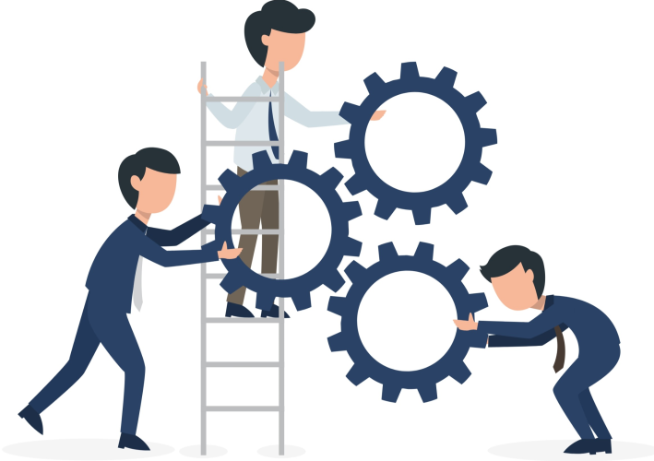
Key Team Processes
Team meetings
Roles and responsibilities
Communications
Decision making
Measuring performance
Team feedback

Slide 19

Key Team Behaviors
Mutual trust
Interdependency
Accountability
Valuing individual differences
Transparency
Learning and recognition

Slide 20

Encourage People to Speak Up
Focus on hearing and capturing ideas (content).
Do not give feedback on the ideas (other process).
Do not react negatively to the content (behavior and process).
In short: Separate content, process, and behavior.

Slide 22
Radar Dysfunctional Team Behaviors [2]
Ignoring others
Having side conversations
Distracting (e.g. using a phone)
Withdrawing
Dominating
Stating opinion as fact

Slide 23
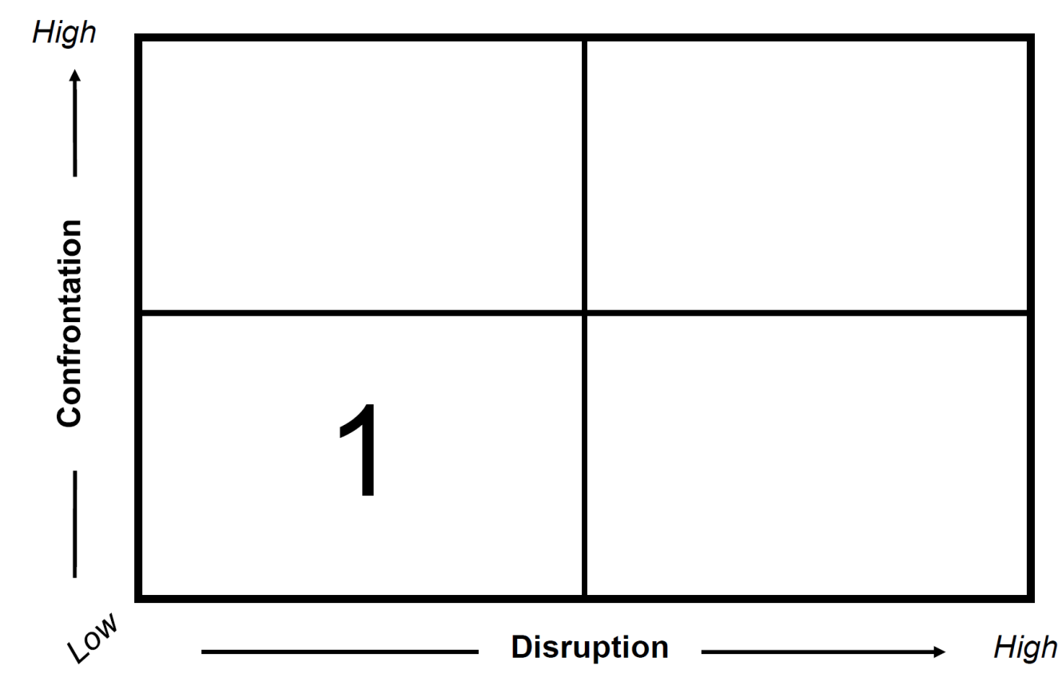
Intervention Grid (I)
Dominating → Brainstorming

Slide 24
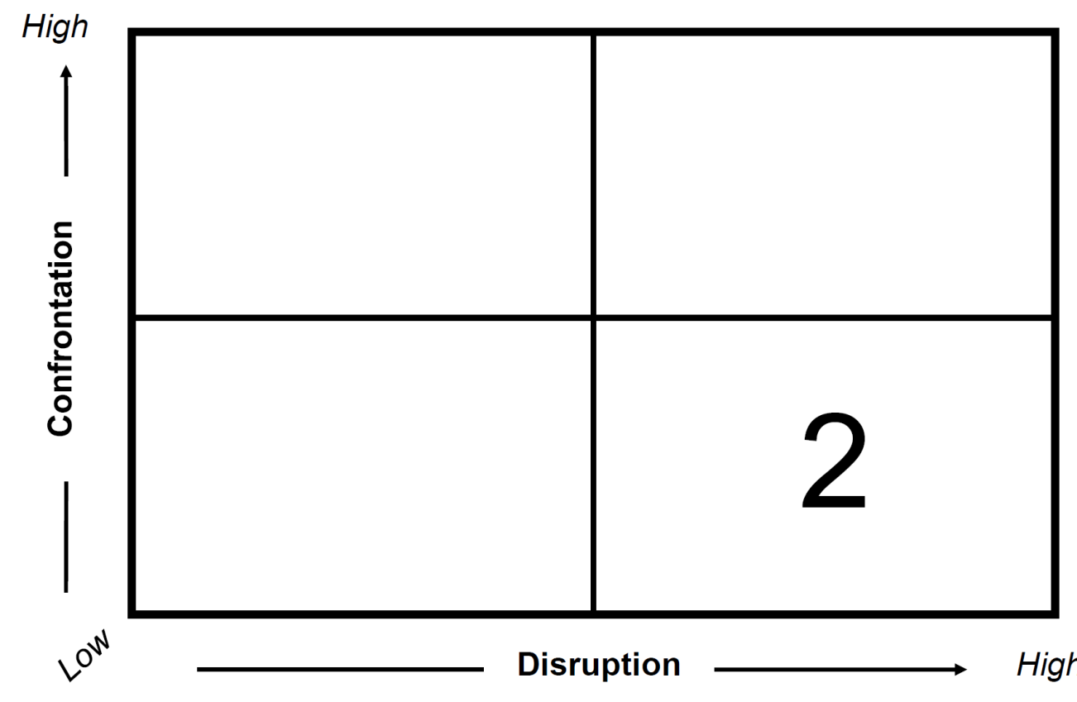
Intervention Grid (II)
Dominating → One by one talking.

Slide 25
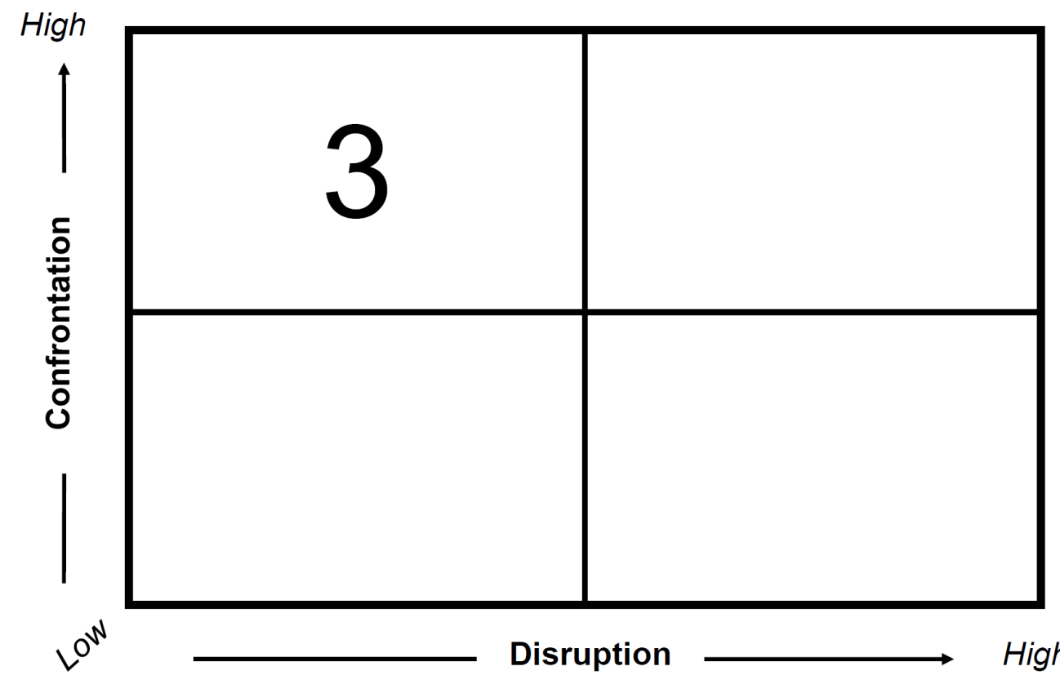
Intervention Grid (III)
Dominating → Talking in private.

Slide 26
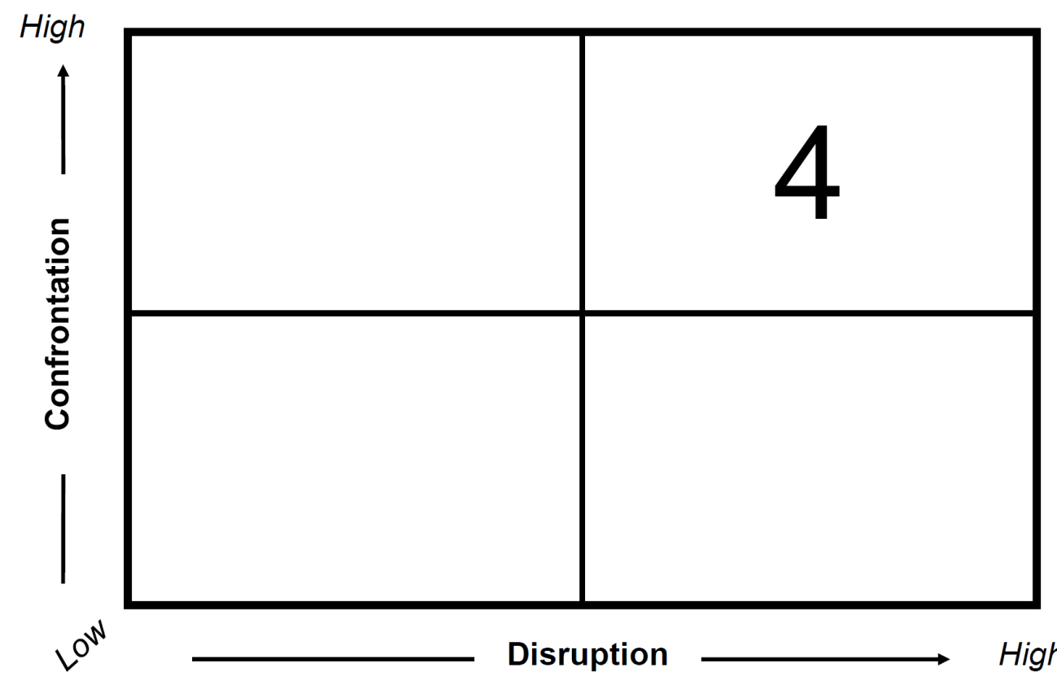
Intervention Grid (IV)
Dominating → Stop meeting, talking in front of group.
Never use this.

Slide 27
Six Other Ways To Deal With Difficult Stakeholders
Reciprocity
Scarcity
Authority
Consistency
Liking
Consensus

Slide 28
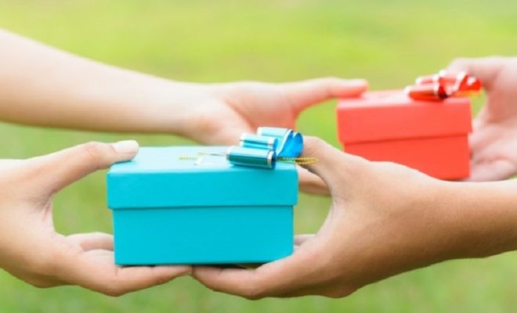
Reciprocity
Others will do things for us if we have first done things for them.

Slide 29

Scarcity
What you do for this stakeholder must be seen as:
Beneficial
Unique
The stakeholder must also understand what they can potentially lose.

Slide 30
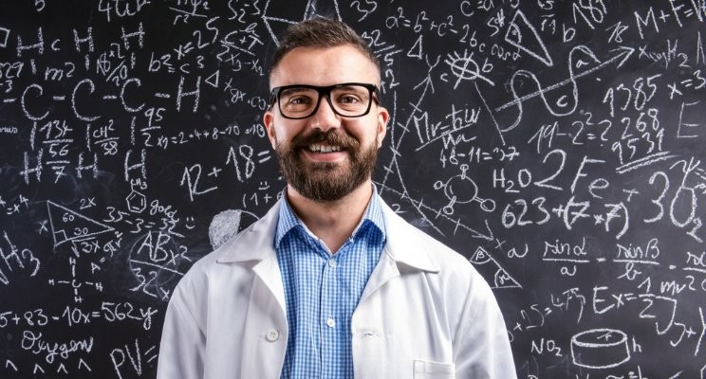
Authority
If you are seen as not just the person with “authority,” but as an authority or expert on what you are attempting to do in the project, people are more likely to agree with you and support what you are doing.

Slide 31

Consistency
Consistency throughout the project in how things are done.
Consistency in how the project integrates with and adheres to organizational processes, procedures, guidelines, and policies.
Both of these can help deal with difficult Stakeholders.

Slide 32

Liking
People will agree more often with people they like.
Take the time to build positive relationships with stakeholders.

Slide 33
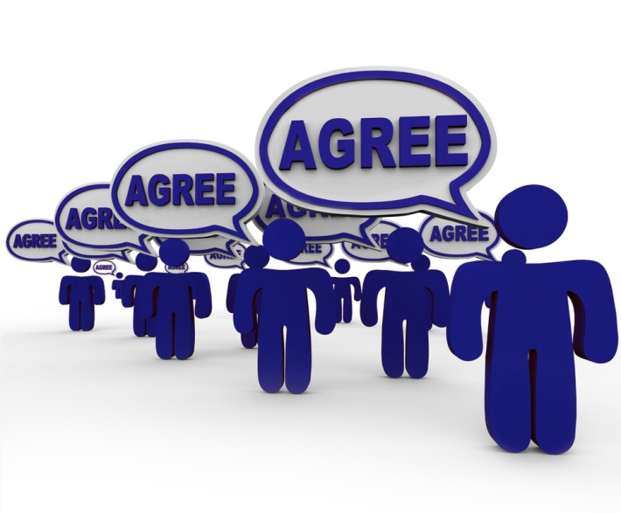
Consensus
As it is within the team, listening to all viewpoints and building consensus on which is the best idea or action that will help the project move forward is also important to stakeholders.

Slide 34
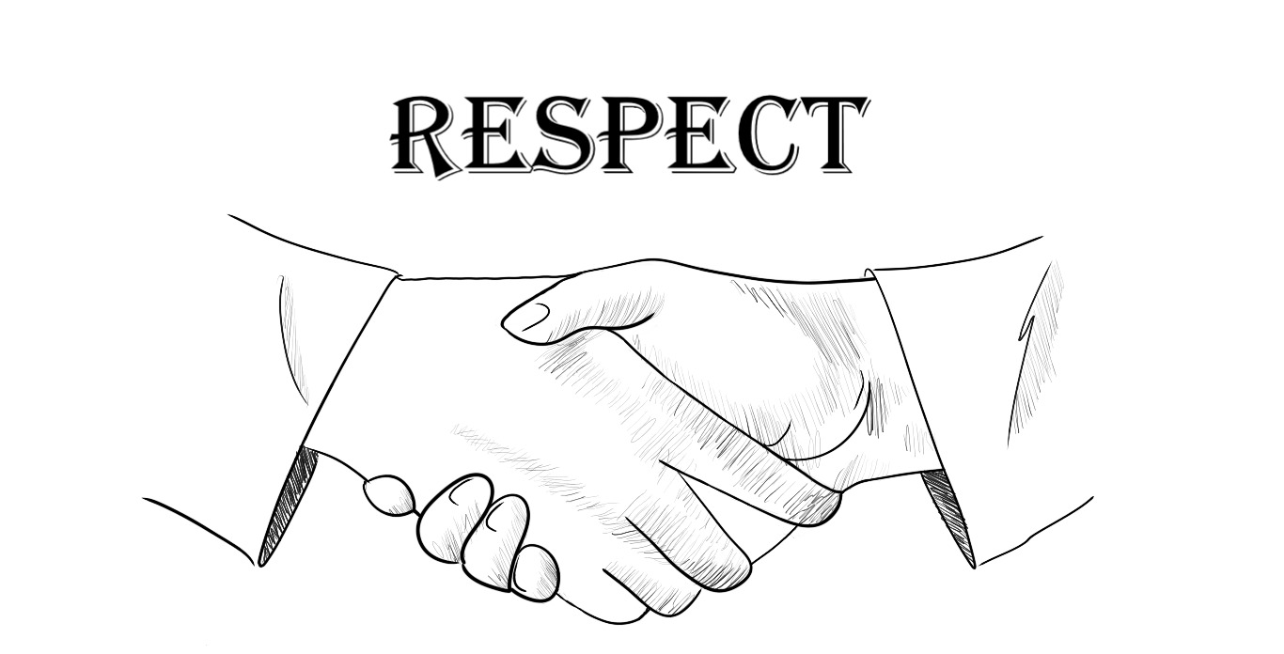
In Summary
Listen to team members and stakeholders.
Treat everyone on the team and every stakeholder with respect.
... And you will have a solid foundation for Dealing With Difficult People.

Slide 35
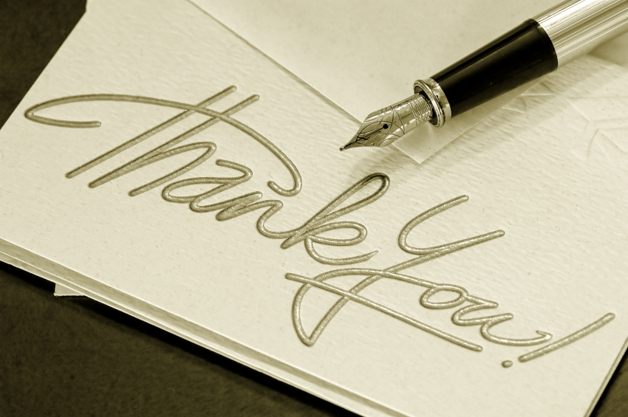
Thank You & See You Again

